Slide 1

The theme of the lesson:
What does your father do?

Slide 2
The aim of the lesson:
Learning objectives(s) that this lesson is contributing to:
C2. Use speaking and listening skills to provide sensitive
feedback to peers
L2. Understand a limited range of short supported
questions which ask for personal information
S1. Make basic statements which provide personal
information on a limited range of general topics

Slide 3
Lesson objectives:
All learners will be able to:
Use some appropriate subject-specific vocabulary to talk on the topic: “What is your name?” with a lot of support
Most learners will be able to:
Use most time expressions on their speech;
Understand the main points in extended talk with some support
Some learners will be able to:
Use a lot of appropriate subject-specific vocabulary to talk on the topic
Understand the main points in extended talk with little support

Slide 4
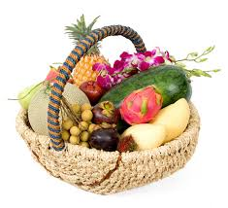
Organization moment
To divide class into 2 groups with the pictures of “fruits” and “vegetables”

Slide 5





II. Check up home task:
What’s your name?
How old are you?
Which class
are you in?
Can you play the guitar?

Slide 6
III. New lesson
23
W
h
8
1
4
a
t
d
o
19
20
15
5
e
s
y
25
o
15
u
8
21
r
18
r
18
15
20
5
6
a
t
h
e
f
4
d
?
?
1
o

Slide 7
New words
A teacher – Мұғалім A baker - наубайханашы
A driver – Жүргізуші A singer – әнші
A nurse - медбике A doctor – дәрігер
A ballerina – балерина A musician – музыкант
A farmer – шаруа An artist – суретші
A builder - құрлысшы A vet – мал дәрігері
A cook – аспазшы A writer – жазушы

Slide 8

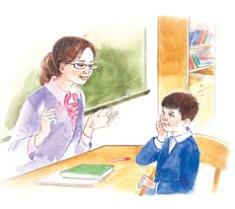

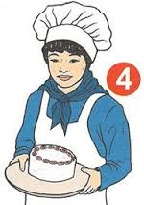
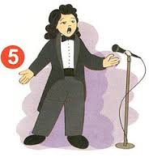
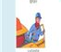
Find the job
I treat people and I work day and night
A doctor
I teach children reading, writing and speaking
A teacher
I work in an office, I resivie and send letters
A secretary
I look up my child and do home works
A housewife
I sing a modern sings
A singer
I drive a public and private transport
A driver

Slide 9

Read the dialogue.
Kate, do you want to be a teacher?
No, I don’t. I don’t want to be a teacher.
What do you want to be?
I want to be a doctor. Do you want to be a driver , Tom?
Yes, I do. I want to be a driver.

Slide 10




What do they want to be?
He, she, it + Vs/es
1.He wants to be a businessman.
1
2.She wants to be a ballerina.
4
4.He wants to be an artist.
3. He wants to be a doctor.
2
3

Slide 11




What do they want to be?
He, she, it + Vs/es
1.He wants to be a baker.
1
2.She wants to be a nurse.
4
4.He wants to be a farmer.
2
3. She wants to be a musician.
3

Slide 12
What do they do?
A singer
…teach children.
…sing songs.
…dance.
…cook .
A singer sings songs.
A ballerina
A ballerina dances.
A teacher teaches
children.
A teacher
He, she, it + Vs/es
A cook/chef
A cook/chef cooks.

Slide 13
What do they do?
A doctor
…help people.
…help animals.
…build houses .
A doctor helps people.
A builder
A builder builds
houses.
A vet helps animals.
A vet
He, she, it + Vs/es

Slide 14
What do they do?
…cut hair.
…paint pictures.
…play the piano.
…write books .
A writer
A writer writes books.
An artist
An artist paints
pictures.
A hairdresser
A hairdresser
cuts hair.
He, she, it + Vs/es
A musician
A musician plays
the piano.

Slide 15

WELL DONE

Slide 16
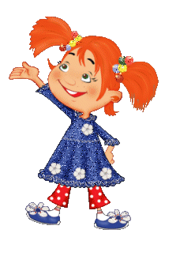
IV. Doing exercises
Exercise1. Find and circle the words
teacherdriverhousewifesecretarydoctorsinger

Slide 17
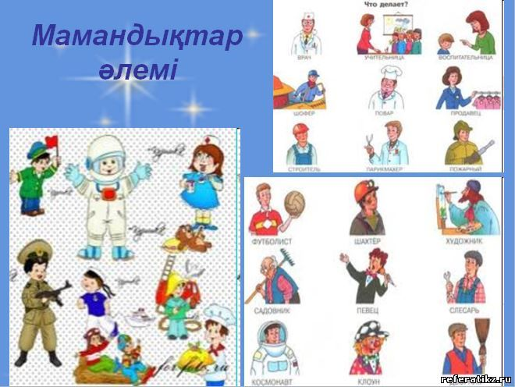
Exercise 2. Match and write
___ a doctor
___ a __________
He is
She is
___ a ____________
_-___ a ___________

Slide 18


Slide 19

Conclusion

Slide 20
Here’s your home task!
To learn by heart new words
To write a short topic about your favourite job

Slide 21



Thank you for your attention!.

